Slide 1
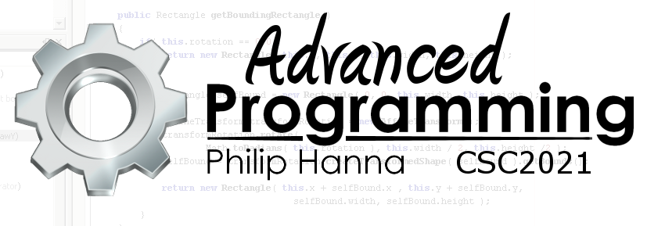
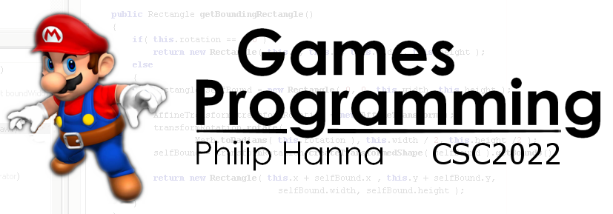
Agile and Lean
Introduction to the principles behind agile and lean software development.
Part 1 – Introduction

Slide 2

Waterfall Model
Being overly optimistic

Slide 3
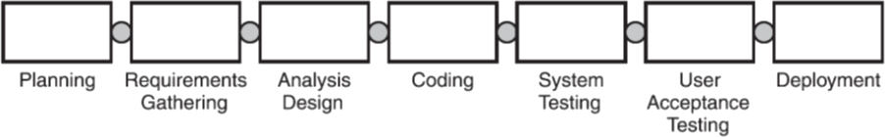
For many years the Waterfall method was the standard software development approach (and still is broadly used).
Waterfall assumes that:
Users can accurately and precisely define what they require upfront before they see or use the product.
The business environment is stable and will not significantly change during the project.
The requirements can be documented in a manner that is consistently and unambiguously understood by developers.

Slide 4

When the delivery date is years away (common on medium/large sized projects) the Waterfall assumptions tend to break down – often disastrously so.

Slide 5

The Waterfall method appeals to (some) companies as it is document and planning intensive.
It provides a detailed and ‘reasonable’ plan alongside a clear control mechanism which promises control over project costs and schedules.

Slide 6

The truth for most projects is that full control over costs and schedules is an illusion - requirements are uncertain and likely to change over time.
The cost and schedule estimates can’t be any more exact and precise than the requirements are.
A better approach is to use a method that is designed to be flexible and adaptable to uncertain user requirements.

Slide 7
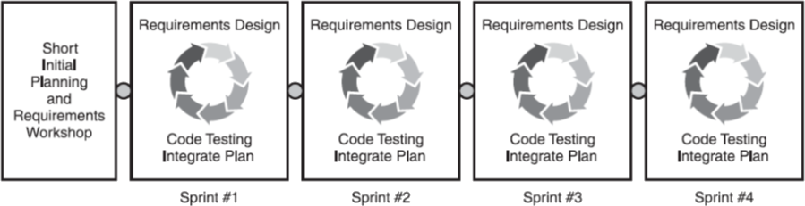
Agile approaches tackle uncertainty by delivering working software to the client on a frequent and regular basis. This enables the client to compare the software against their requirements and therefrom shape the development.

Slide 8

The Agile Manifesto

Slide 9

Agile Principles
In 2001, a group of software experts drafted the Agile Manifesto:
“We are uncovering better ways of developing software by doing it and helping others do it. Through this work we have come to value:
Individuals and interactions over processes and tools
Working software over comprehensive documentation
Customer collaboration over contract negotiation
Responding to change over following a plan
That is, while there is value in the items on the right, we value the items on the left more.”

Slide 10


We increase return on investment by making continuous flow of value our focus.
We deliver reliable results by engaging customers in frequent interactions and shared ownership.

Slide 11


We expect uncertainty and manage for it through iterations, anticipation, and adaptation.
We unleash creativity and innovation by recognizing that individuals are the ultimate source of value, and creating an environment where they can make a difference.

Slide 12
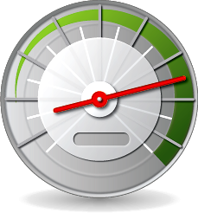

We boost performance through group accountability for results and shared responsibility for team effectiveness.
We improve effectiveness and reliability through situationally specific strategies, processes and practices

Slide 13
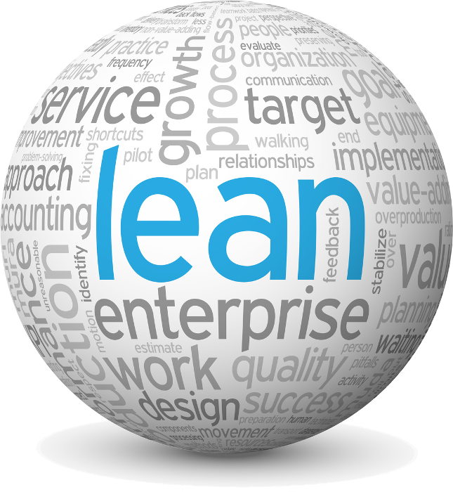
Lean

Slide 14
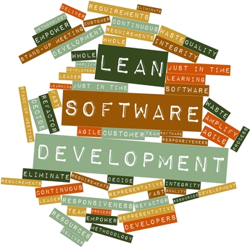
The roots of agile approaches are in “lean” development, which originated in lean manufacturing concepts (most famously the Toyota Production System).
Lean is a systematic approach to identifying and eliminating waste by continuously improving processes. Alongside this, lean focuses on maximising value to the customer.

Slide 15
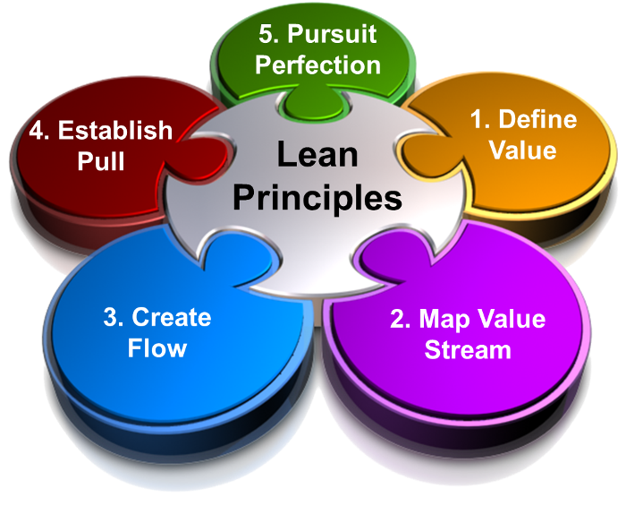
: Principles
Lean is underpinned by several principles.
All of the principles are important, although for this module the notions of clearly defining value and eliminating waste are of particular relevance.

Slide 16
: Defining Value
Value-Added— Things that the client wants (and would pay money for)
Waste—Things that consume resources but are of no importance to the client
In the context of this project, ask what is going to provide maximum ‘bang for your buck’.
You should always spend your valuable and limited time on activities that offer value to your project.
Aside: Non-value added are things that do not add value to the client but are needed for other reasons (e.g. regulatory/legal requirements, etc.).

Slide 17
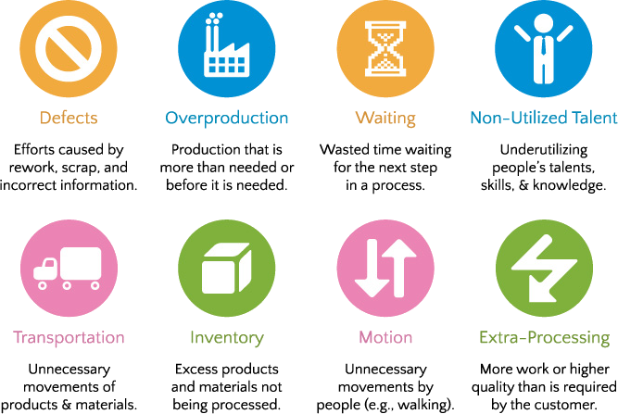
: Eliminating Waste
Lean identifies a number of different types of waste (which need to be contextualised in terms of software engineering).
In the context of this project you should get into the habit of viewing how you spend your time and how much of your time was spent ‘adding value’.

Slide 18



Slide 19

Talk of ‘mapping the value chain’, ‘empowering the team’, etc. might be viewed as hollow ‘management talk’.
This isn’t the case for agile and lean approaches – please do think deeply about the underlying principles and why they matter.
Too many ‘traditional’ projects have wasted time and effort creating software that isn’t fit for purpose. Agile and lean approaches have a much better track record. You should understand why this is the case.

Slide 20

Embracing an agile and lean philosophy will maximise the marks you receive in your uni projects…

Slide 21

Key takeaways:
Traditional waterfall approaches make a number of assumptions that can often be unrealistic.
Agile software development approaches are designed to be flexible and adaptable to uncertain user requirements.
Lean software development approaches provide a means of focusing on what is really important and cutting out any waste.
Agile and Lean approaches complement one another.

